Slide 1
Software product management Introduction
Nandagopal Govindan

Slide 2
Contents
Software products scenario
What is spurring product industry?
Different product categories
Project business vs Product business
What is Product management?
About this course

Slide 3
Software products scenario

Slide 4
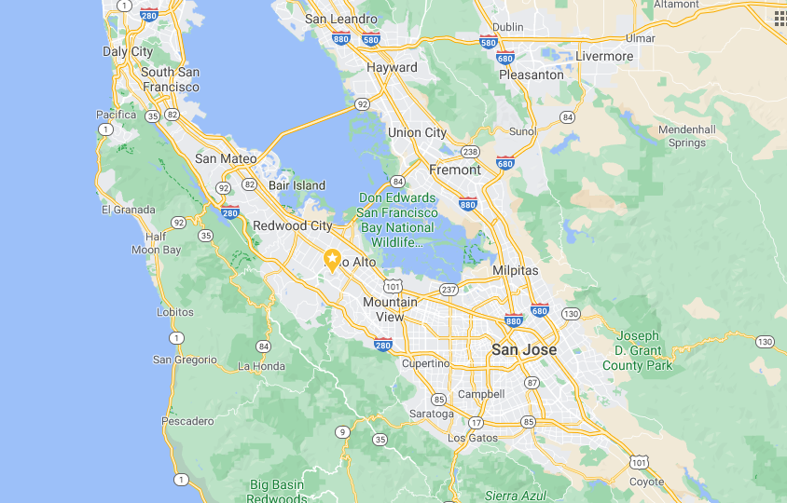
Software product revolution started in Silicon valley
Stanford University
Silicon valley
Early companies in Silicon valley: HP, Xerox, Apple, Oracle,…..

Slide 5
How Silicon Valley became successful?
Convergence of Academia (Stanford, UC Berkley), the Private Sector, and Government
High Density of Wealthy Investors and Funding Institutions
Inspiration From Past Success Stories
Cultural diversity: Half the startups belong to Indians and Chinese
Level-headed Approach to Failure

Slide 6
Today there are 1200+ unicorns across the world
Country | # of Unicorns | +/- | %
United States | 703+ | 37 | 48
China | 340+ | 24 | 24
India | 67+ | -1 | 4-5
United Kingdom | 53+ | 4 | 4
EU Countries | 109 |  | 8-9
https://www.hurun.net/en-US/Info/Detail?num=9K1G2SK5X7CX#:~:text=USA%20LED%20WITH%20703%20UNICORNS,WITH%2053%20UNICORNS%2C%20UP%204.
https://www.cbinsights.com/research-unicorn-companies

Slide 7
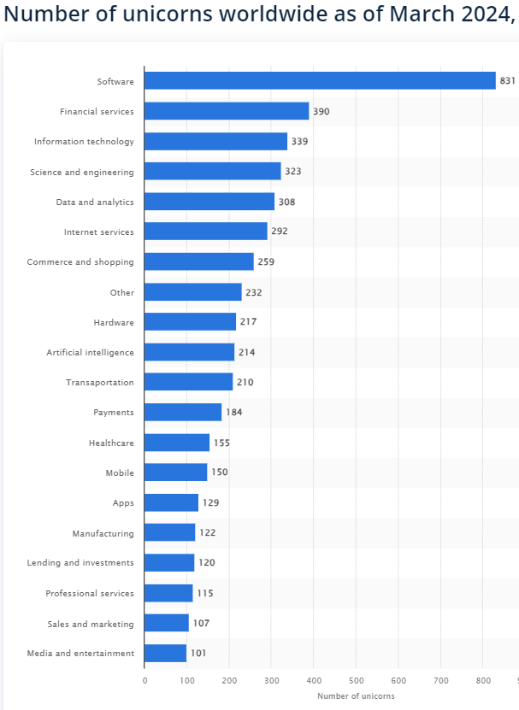
Unicorns by industry
https://www.statista.com/statistics/1093261/number-of-global-unicorns-by-industry/#:~:text=Most%20of%20the%20world's%20unicorns,were%20active%20in%20this%20sector.
https://www.ventureintelligence.com/Indian-Unicorn-Tracker.php

Slide 8
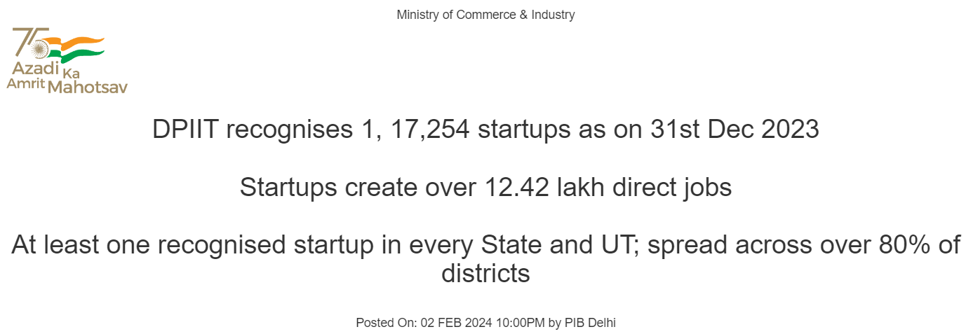
Growth of start-ups in India
India Home To 1.4 Lakh Startups As Of June: Govt
https://inc42.com/buzz/india-home-to-1-4-lakh-startups-as-of-june-govt/

Slide 9
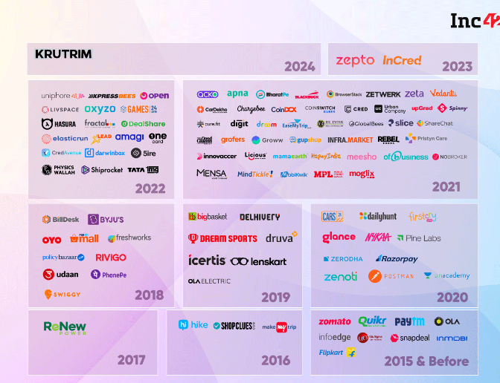
Unicorns in India

Slide 10
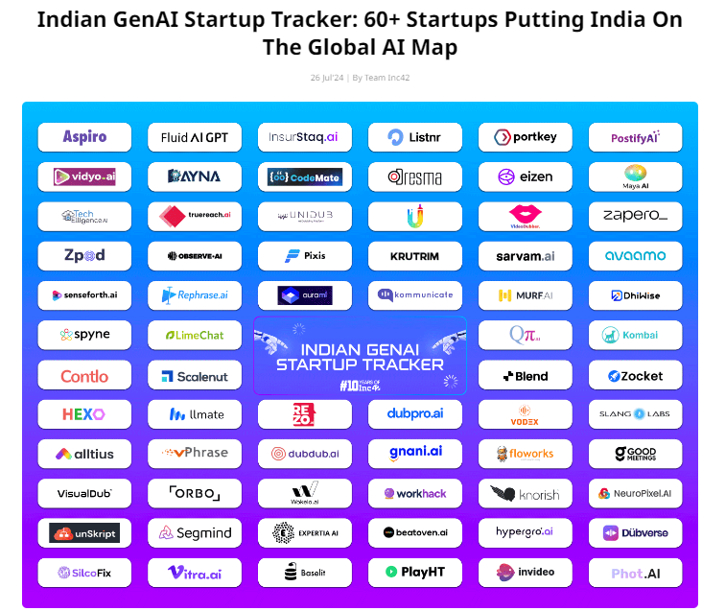
https://inc42.com/startups/indian-genai-startup-tracker/

Slide 11
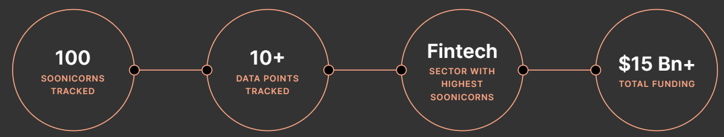
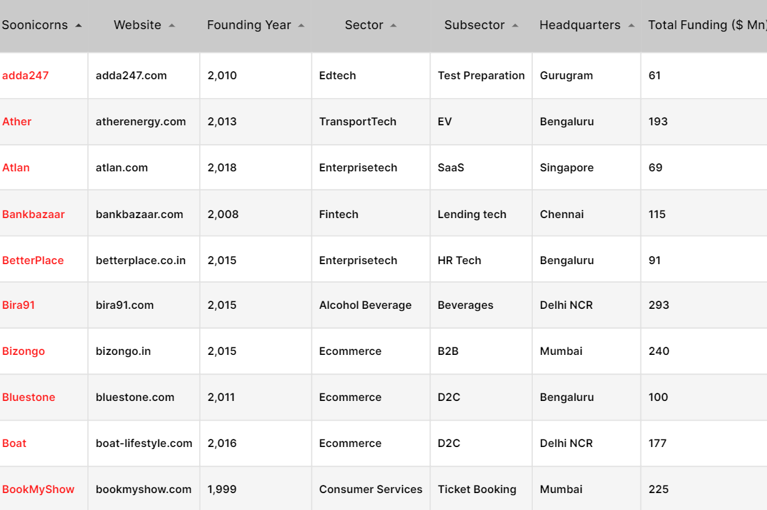
Soonicorns
https://tracxn.com/d/soonicorn-club/soonicorns-in-india/__ujYf3QI9FSnpS3x-zJCSwnay2nENQhm1kAN-U8-6Kfg
https://inc42.com/the-indian-soonicorn-tracker/#tracker

Slide 12
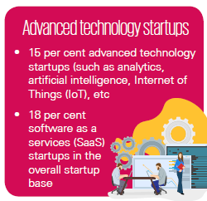
Tech start-ups – Advanced technology (India)
KPMG report: https://home.kpmg/in/en/home/insights/2019/01/startup-landscape-ecosystem-growing-mature.html

Slide 13
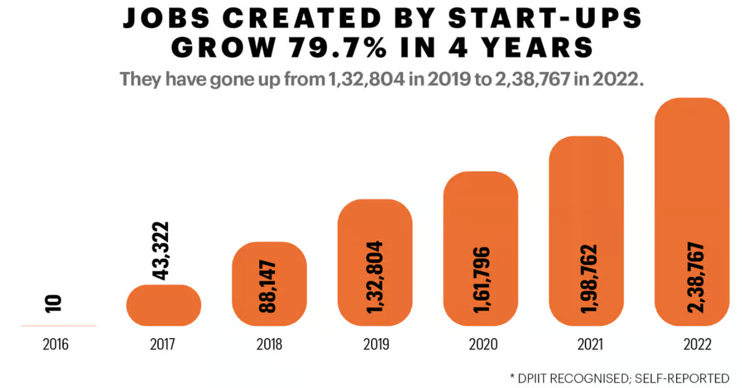
Tech start-ups – job creation (India)
https://www.fortuneindia.com/infographics/the-start-up-boom/112577

Slide 14
What is spurring product industry?
Global market reach
Cloud resources – Amazon AWS, Microsoft Azure, IBM, Google
Funding - 100 angel investors in 2020
Talent pool
https://www.inc.com/peter-cohan/5-keys-to-inventing-new-products-that-spur-growth.html

Slide 15
Product categories

Slide 16
Product categories
By industry – Finance, Health, Retail, Travel
By technology – AI/ML, Analytics, Robotics, IoT
B2B vs B2C
SaaS vs On-premise
Mobile vs Web
Regular vs API products (Payment gateway, Google Maps, SMS gateway, Banking API)
Product vs Product-cum-service (Ola, Uber, Flipkart)
Product (Paytm), Product platform (Ola), Product family (Office on Windows, Office on Mac, Office on Android), Product Line (Roclwell Collin avionics)
Any other?

Slide 17
Industry segments
E-Commerce – Amazon, Flipkart
HealthTech – Practo, Tata Health, CogniAble
FinTech – Paytm, Wealthy
EdTech - Byju
TravelTech – MakeMyTrip, Tripadvisor
Logistics – Ecom express, Dunzo, Delhivery
Consumer services – Swiggy,
Enterprise Tech – Zoho, Kissflow, Wooqer
Deep tech - Niflr, Logically, AskSarkar
Software dev – Postman, WorkDuck

Slide 18
Product platform
Product platform: Amazon AWS, Android, Uber, PayPal, Facebook
The technical foundation / eco system on which several software products are based.

Slide 19
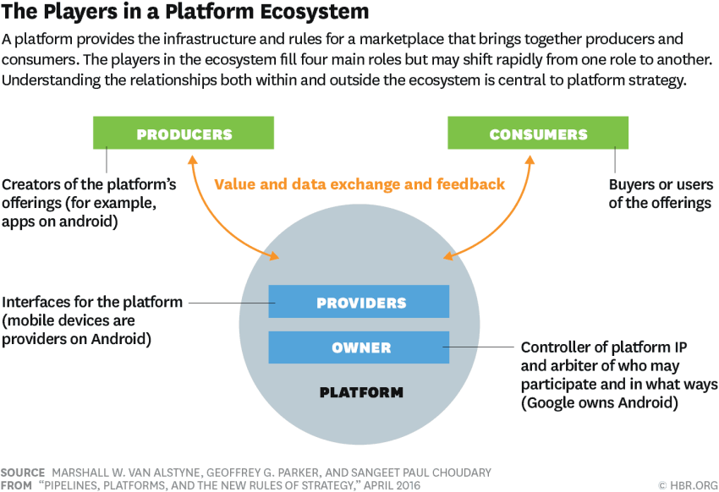
Product platform
Image Source: https://hbr.org/2016/04/pipelines-platforms-and-the-new-rules-of-strategy

Slide 20
Product family
Product family: Microsoft Office (Word, Excel, PowerPoint, OneNote, Outlook)
A group of software products that are marketed as belonging together under a common family name

Slide 21

Product line
Product line: Rockwell Collins Avionics systems for different helicopters
a collection of similar software systems from a shared set of software assets using a common means of production.

Slide 22
Product business and Project business
Dimension | Product | Project
Risk | High | Low
Returns | High | Low
Duration | Ongoing | Pre-determined
Customers | Many | One
Objective | Discovered | Given
Funding | Internal & external | Internal
Marketing effort | High | Low
Management | Strategic | Tactical / operational

Slide 23
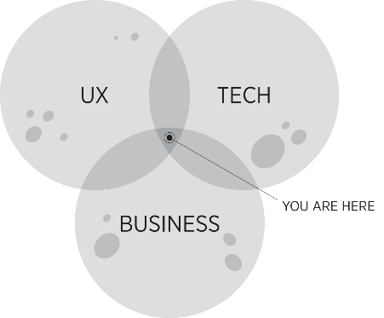
What is Product Management?
“The job of a product manager is to discover a product that is valuable, usable and feasible.” – Marty Cagan, Author of ‘Inspired’
“Product management is an intersection between business, user experience, and technology” – Martin Eriksson, Author of Product Leadership
“Product management is the glue that holds together all the various functions” - Ken Norton, Product Partner at Google Ventures

Slide 24
Product Management role
You need to be really good at strategy, be inspirational, and understand the long-term picture.
At the same time, you have to be really good at the operational side and making things happen
Setting a vision
Creating a roadmap
Build the product
Talk to customers
You need the soft skills of persuasion, negotiation, storytelling, vision setting and communication

Slide 25
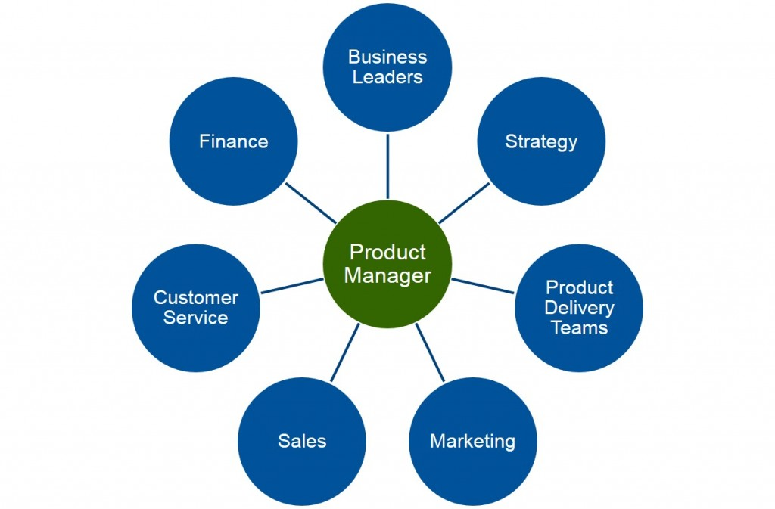
Product Management role
Ref: Product Plan.com

Slide 26
About the course
Hope you have handout.

Slide 27
Sharing thoughts
Name one product company you admire.
What is the reason you admire this company?

Slide 28
Appendix

